Slide 1
Training : Python Date : 08-Jul-2024

Slide 2
Training content : 08-Jul-24:
Python 3.11 - Installation
Inbuilt IDE - IDLE file location.
Pycharm installation – Software product of Vendor JetBrains
Java vs Python
Compiler & interpreter
Variables syntax, Object References, type() , id()
Data types

Slide 3
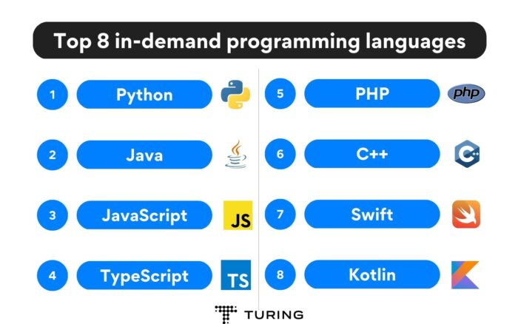
Popular languages :

Slide 4
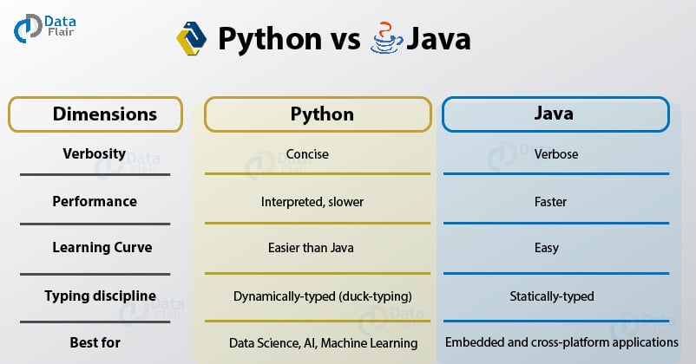
Python vs Java

Slide 5
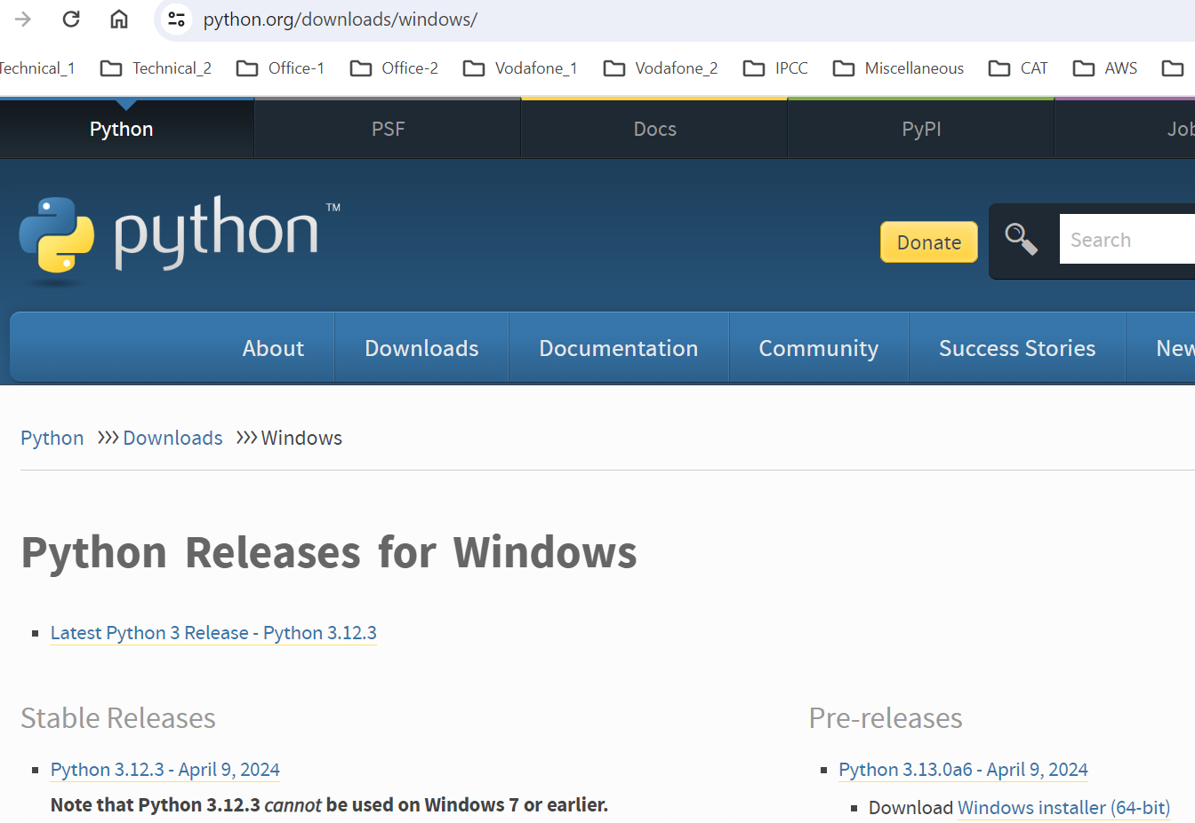
Python & Anaconda - download
Python URL : python.org
Anaconda : anaconda.com Python download :

Slide 6
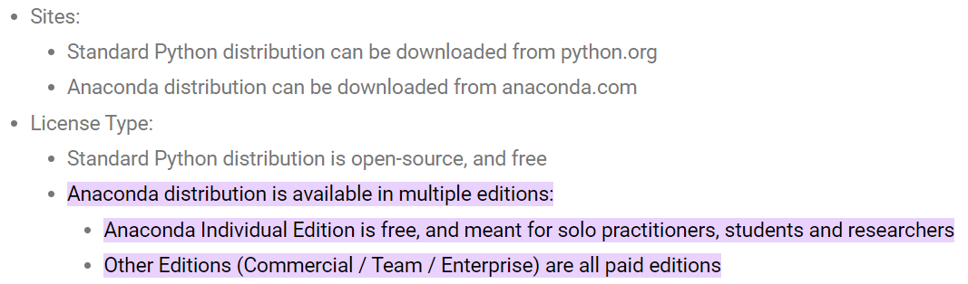

Anaconda – Individual edition

Slide 7
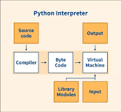
python (interpreter) : First compiles, & then, Interpretes

Slide 8
Python syntax :
- dynamic data typing
- no use of curly braces or semicolon
- uses the indentation to define a block of code

Slide 9
Variables syntax :
The first character of the variable must be an alphabet or underscore ( _ ).
All the characters except the first character may be an alphabet of lower-case(a-z), upper-case (A-Z), underscore, or digit (0-9).
Identifier name must not contain any white-space, or special character (!, @, #, %, ^, &, *).
Identifier name must not be similar to any keyword defined in the language.
Identifier names are case sensitive; for example, myname, and MyName is not the same.

Slide 10
Variables name_format
Camel Case - In the camel case, each word or abbreviation in the middle of begins with a capital letter. There is no intervention of whitespace. For example - nameOfStudent, valueOfVaraible, etc.
Pascal Case - It is the same as the Camel Case, but here the first word is also capital. For example - NameOfStudent, etc.
Snake Case - In the snake case, Words are separated by the underscore. For example - name_of_student, etc.

Slide 11
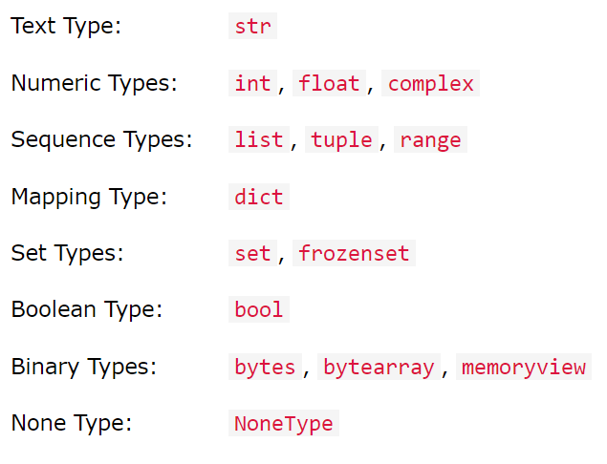
Data types :

Slide 12
String data type
- can use single, double, or triple quotes to define a string.
- operator + is used to concatenate two strings
- operator * is known as a repetition operator as the operation “Hello" * 2 returns ‘HelloHello’ .
- format api -- f”Employee age is {age:.0f}”
Example :
str1 = 'hello Arif\’s team' #string str1
str2 = ’ Good morning' #string str2
print (str1[0:2]) #printing first two character using slice operator → he
print (str1[4]) #printing 4th character of the string → o
print (str1*2) #printing the string twice -→ hello Arif’s teamhello Arif’s team
print (str1 + str2) #printing the concatenation of str1 and str2

Slide 13
Casting :
price = float(450) # price will be 450.0
rollNumber = int(‘2101’) # rollNumber will be 2101 Assigning multiple values to multiple variables: a,b,c=5,10,15 x = y = z = "Orange“ fruits = ["apple", "banana", "cherry"] x, y, z = fruits print(x) print(y) print(z)

Slide 14
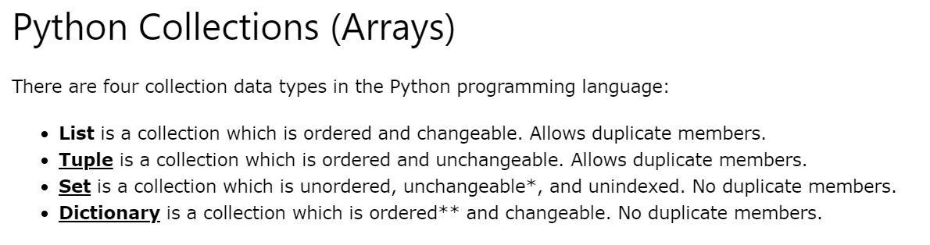
Collections :

Slide 15
List data type : - Similar to arrays .
- Mixed data types. Example :
list1 = [11, "hi", “Good morning", 25]
print(type(list1))
#Printing the list1
print (list1)
# List slicing
print (list1[3:])
# List slicing
print (list1[0:2])
# List Concatenation using + operator
print (list1 + list1)

Slide 16
Tuple :
- similar to the list in many ways.
- contain the collection of the items of different data types.
- items of the tuple are separated with a comma (,) and enclosed in parentheses ().
- read-only data structure as we can't modify the size and value of the items of a tuple.

Slide 17
Tuple - example
tup = ("hi", "Python", 2)
# Checking type of tup
print (type(tup))
#Printing the tuple
print (tup)
# Tuple slicing
print (tup[1:])
print (tup[0:1])

Slide 18
Dictionary data type :
-- key:value pair -- internally buckets are used, as in Java. -- initial bucket size is 8. 8 different keys are allowed initially. After 8 keys, bucket size doubles. -- To manipulate dictionary, following Apis used : clear(), pop(), update(), items().
Example :
d = {1:’Saravana', 2:’Sumanth', 3:’Rajesh', 4:’Vladimir'}
# Printing dictionary
print (d)
# Accesing value using keys
print("1st name is "+d[1])
print("2nd name is "+ d[4])
print (d.keys())
print (d.values())

Slide 19
Set :
unordered collection of the data type.
iterable, immutable(can modify after creation)
unique elements.
Following Apis used : update(), discard(), remove(), add(), check an item whether exists ,using in & not in

Slide 20
set1 = set()
set2 = {'James', 2, 3,'Python'}
#Printing Set value
print(set2)
# Adding element to the set
set2.add(10)
print(set2)
#Removing element from the set
set2.remove(2)
print(set2)
for val in set2 :
print(val)

Slide 21
Dictionary :
- unordered set of a key-value pair of items.
d= {1:'Jimmy', 2:'Alex', 3:'john', 4:'mike'}
# Printing dictionary
print (d)

Slide 22
Delete a variable
del <variable_name>
Maximum Possible Value of an Integer in Python
a = 4444444444400000000000000000000000000000009999
a = a + 10
print(type(a))
print (a)

Slide 23
Local variables
def add():
a = 50
b = 40
c = a + b
print("The sum is:", c)
add()

Slide 24
Global variables
x = 101
def mainFunction():
global x
print(x) # value 101 is printed
x = 'Welcome Team’
print(x) # vaue Welcome Team is printed
mainFunction()
print(x)

